Slide 1
Week 2B – Data Acquisition & Introduction to myRIO
Advanced Mechatronics System Design – MANU2451
Dr Chow Yin LAI
Edited by Dr Milan Simic School of Engineering RMIT University, Victoria, Australia Email: milan.simic@rmit.edu.au

Slide 2
Teaching Schedule
Week |  | Class Activity Before | Lecture | Class Activity During or After
1 |  |  | Introduction to the Course / Introduction to LabVIEW | LabVIEW Programming
2 |  |  | Introduction to LabVIEW / Data Acquisition | LabVIEW Programming
3 |  |  | Gripper / Introduction to Solidworks / Safety | Gripper Design
4 |  |  | Sensors I | myRIO Programming for Sensor Signal Reading / Gripper Design
5 |  |  | Sensors II | myRIO Programming for Sensor Signal Reading
6 |  |  | Actuators I | 3D Printing
7 |  | LabVIEW Assessment. | DC Motors I | Matlab Simulink Simulation
8 |  | Design report submission | DC Motors II | Matlab Simulink Simulation / myRIO Programming for Control
9 |  |  | Actuators II | Matlab Simulink Simulation / Assemble Gripper
10 |  |  | Modeling and System Identification | Matlab Simulink Simulation / Test Gripper
11 |  |  | Artificial Intelligence I | Matlab Simulation / Finalize Gripper
12 |  | Gripper Demonstration / Submission of Report | Artificial Intelligent II | Revision

Slide 3
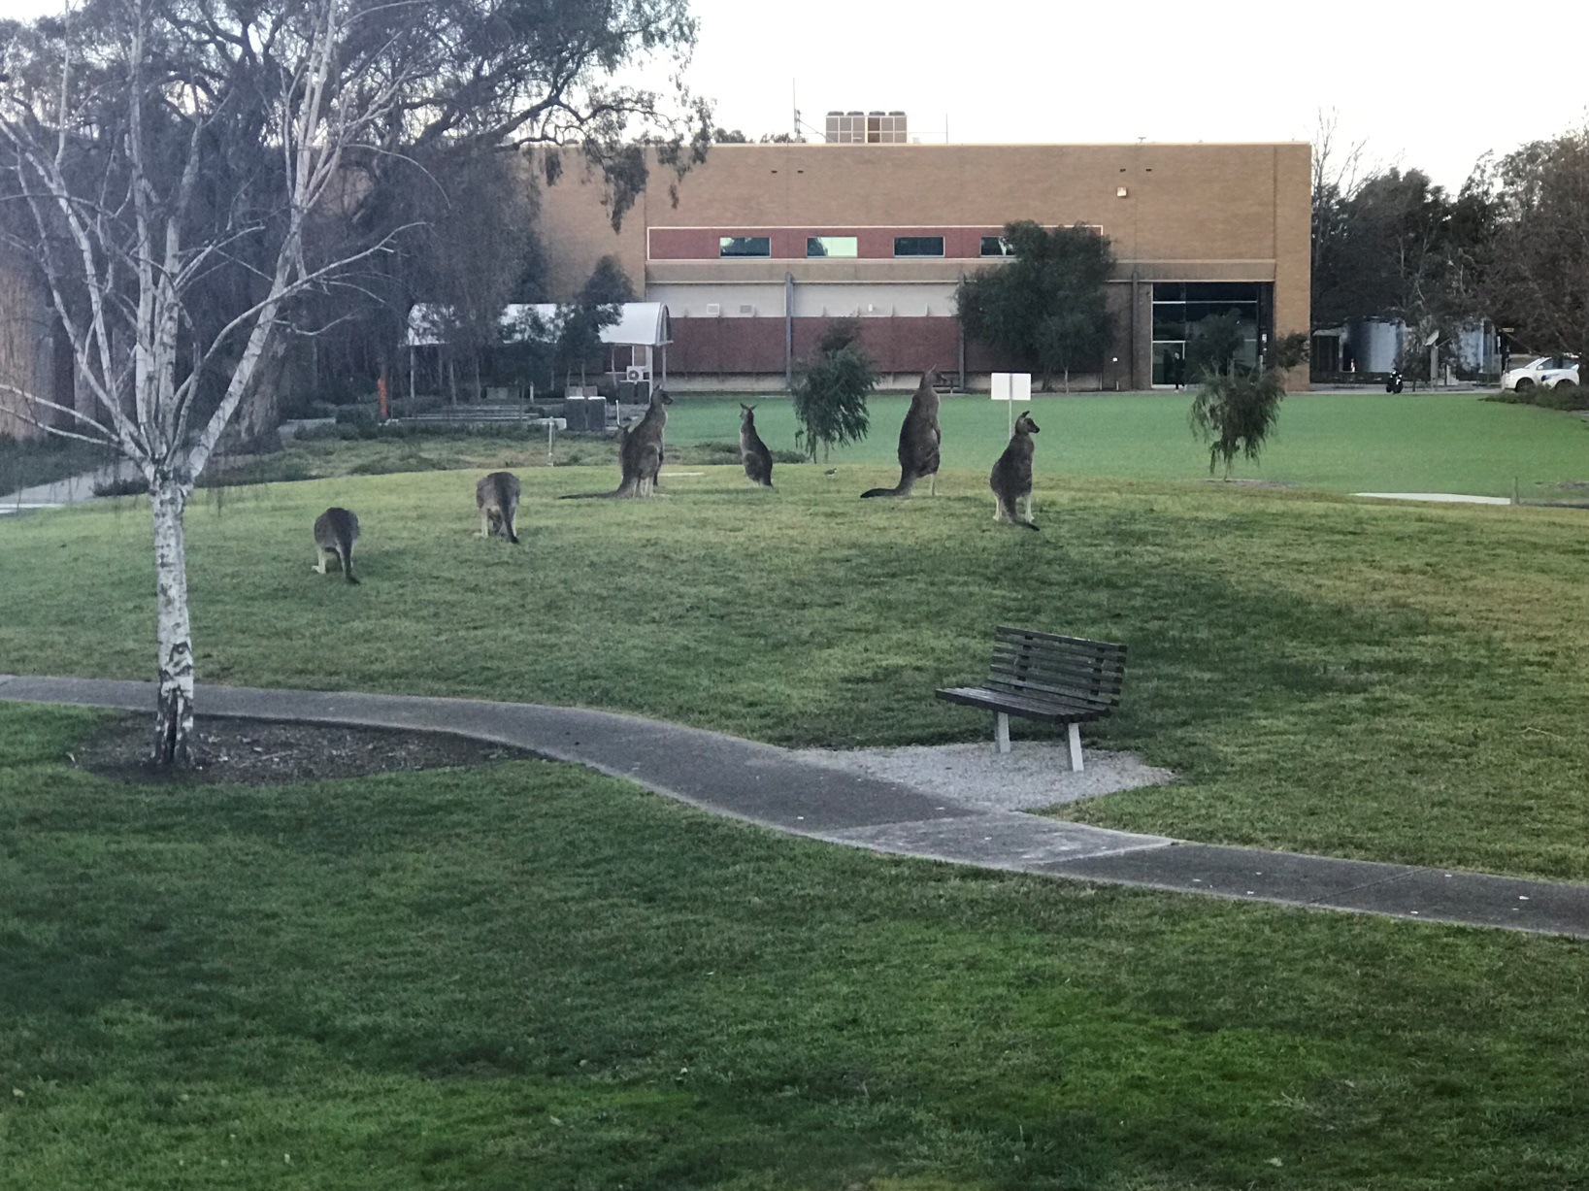
Teams’ Allocation Collection of Design Kits

Slide 4
Mechatronics System Components
D/A, Amplifier, PWM etc.
Output Signal Conditioning and Interfacing
Actuators
Sensors
Input Signal Conditioning and Interfacing
Digital Control Architectures
Microcontroller, Control Algorithm, PLC, etc.
DC Motor, Stepper,
Servo etc.
Mechanical
Computer
Electrical / Electronics
Control Systems
Potentiometer, Strain gauge, Encoder etc.
A/D, Filters, Amplifiers etc.

Slide 5
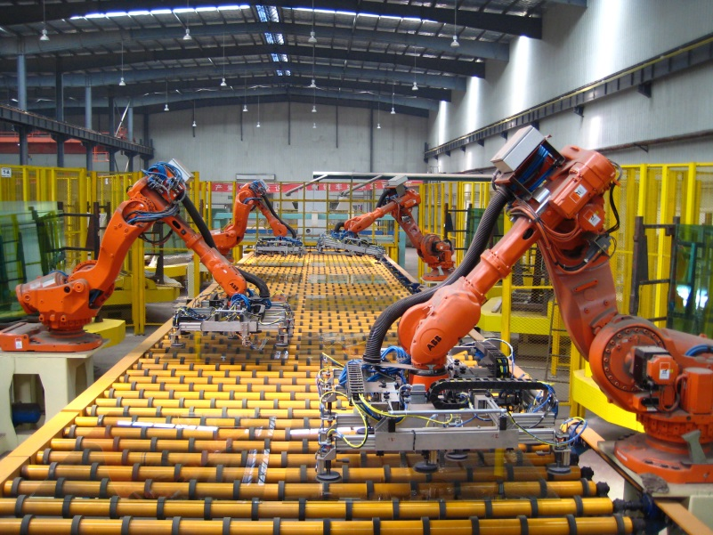
Mechatronics System Components
Sensors: Encoder at each joint
Input signal interfacing
Robot controller:
Generate desired motion trajectory
Calculate current end-effector position based on angular position (kinematics)
Calculate desired angular position for desired end-effector position and trajectory (inverse kinematics)
Control algorithm
Safety, collision detection etc.
Industrial Robots
https://commons.wikimedia.org/wiki/File:Float_Glass_Unloading.jpg
Actuators: Geared motor at each joint
Output signal interfacing

Slide 6
Content
Introduction to Data Acquisition
Introduction to NI myRIO

Slide 7
Content
Introduction to Data Acquisition
Introduction to NI myRIO

Slide 8
PC-Based Data Acquisition
Data acquisition (DAQ) is one of the main reasons why people use LabVIEW.
Sensors (Temperature, force, light, position etc.) will ultimately provide an electrical voltage or current, either in a digital form or analog form.
Thus if the data acquisition hardware can read in these signals, we will be able to create a LabVIEW virtual instrument to acquire and process the data.
Data Acquisition Hardware
Signals
PC & LabVIEW

Slide 9
Choosing DAQ Hardware
What type of signals are you measuring?
Analog / Discrete (Digital)?
How many AI / AO / DI / DO do you need? **
What are the ranges of the input and output voltages?
Typically 0-5V and 4-20mA
What precision or resolution is needed?
12 bit / 16 bit / 24 bit?
What is the minimum sampling rate?
Is portability, ruggedness, isolation or cost an issue?
What operating systems do you have?
Windows, Linux, Mac OS?
What connector types are available?
PCI, PC-Card for laptops, USB?
e.g. 0-5V, resolution 12 bit → 0-5V is divided into 2¹² equal steps, thus the resolution is 1.22mV

Slide 10
Signal Conditioning
Measurements are often corrupted with noise.
50Hz noise from AC power and lights.
RF noise from fluorescent lights, mobile phones, microwaves.
Etc.
Also, signals maybe very small to be measured properly.
Or, the sensor signal may be nonlinear.
Without optimizing real signals for the DAQ device, you cannot rely on the accuracy of the measurement!

Slide 11

Signal Conditioning and Conversion
Signal modification
Amplification
Attenuation
Modulation
Digitising: Analog to Digital (AD) conversion
Digital to Analog (DA) conversion

Slide 12
Signal Conditioning
A middle stage between the signal generation (obtaining the signal) and signal processing.
Amplification is the most common manipulation technique.
Sensing stage (sensor),
Signal conditioning stage
Processing stage ( A/D Conversion and a micro-controller application).
Sensing
Conditioning
Processing

Slide 13
Interface Characteristics and Component Matching
Product Information
TTL, ECL, CMOS – Logic level interfacing
Opto-isolators / Optcouplers
Relay Logic, Solenoids
Power electronics / High power interfacing

Slide 14
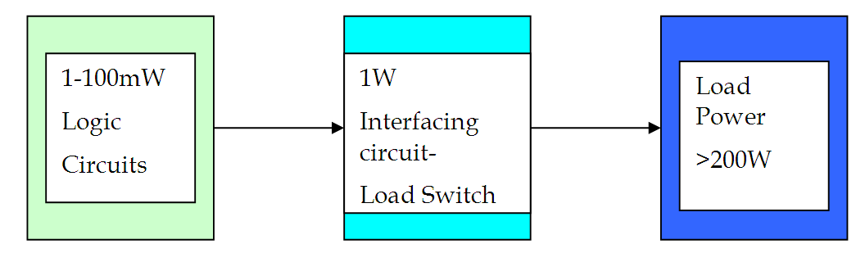
Power Requirements
Logic circuit power level is sufficient to activate relay coil.
It is assumed to use 1W when energised.
Relay contacts, after that, control load of more than 200W.

Slide 15
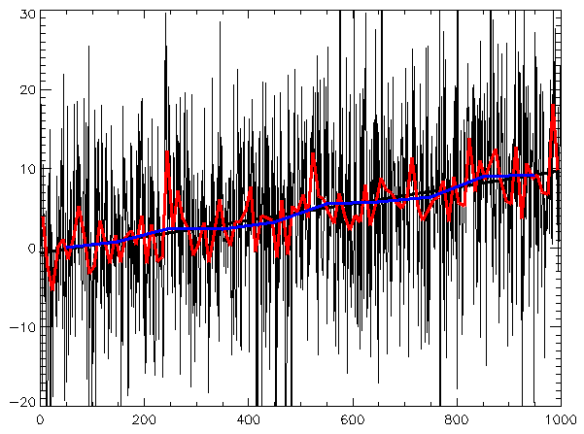
Signal Conditioning – Filtering
Filtering:
Rejects unwanted noise within certain frequency range.
Lowpass, bandpass filters, notch filters, anti-aliasing.
Signal Filtering
https://en.wikipedia.org/wiki/Linear_trend_estimation

Slide 16
Signal Conditioning – Filtering
Low pass filter:
Passes signals with frequency lower than certain cut-off frequency.
The impedance (≈ resistance) of the capacitor is
which means it decreases as frequency increases.
V_{in} from sensor (with noise)
V_{out} to DAQ device (with less noise)

Slide 17
Signal Conditioning – Filtering
Using voltage divider rule, the voltage across capacitor in the above circuit is:
Where Time Constant is T=RC, and the input-output relationship is thus:
V_{in} from sensor (with noise)
V_{out} to DAQ device (with less noise)

Slide 18
Signal Conditioning – Filtering
We can now calculate the gain (and phase) of the filter.
From , the gain is
When frequency (ω) of V_{in} is low, the gain is approximately 1
Low frequency signals pass through without much attenuation
When frequency (ω) of V_{in} is exactly 1/T, the gain is
is called the Time Constant of the filter.
is called the cut-off frequency.
As frequency (ω) of V_{in} gets higher, the gain will get smaller.

Slide 19
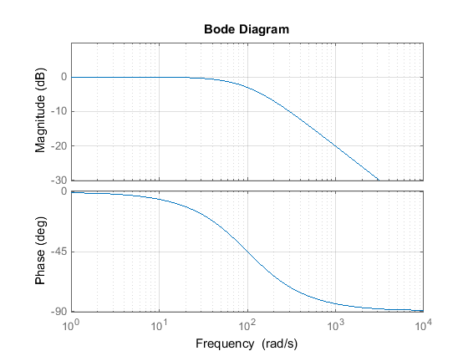
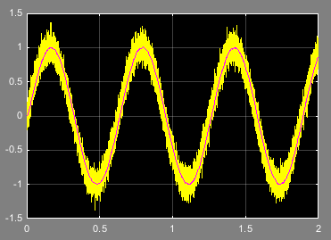
Signal Conditioning – Filtering
E.g. R = 10 KOhm, C = 1 uF → T = 0.01s, ω_{c} = 100 rad/sec, f_{c} = 628Hz
Simulated signals:
Yellow: 10 rad/sec sine wave, corrupted with white noise with variance 0.01
Red: Filtered signal
Bode Plot

Slide 20
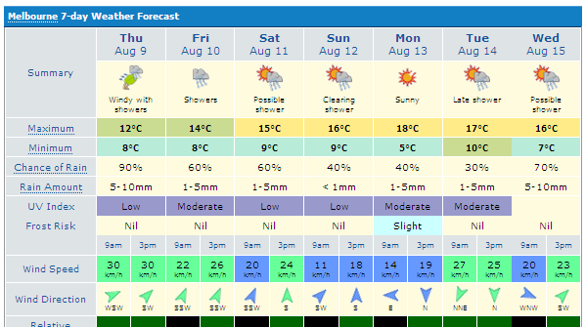
Average Temperature for 7 days

Slide 21
Finite Impulse Response Filtering (FIR) Algorithm
DSP Algorithms
Average temperature for 7 days

Slide 22
Finite Impulse Response Filtering (FIR) Algorithm
DSP Algorithms
FIR Filter is a discrete-time system
It converts and input signal x[n] into output signal y[n] using weighted summation
Filter coefficients {b_{k}} are constants that define filter characteristics, and M is the order of the filter

Slide 23
FIR Filtering, or Running Average Filter
DSP Algorithms
When
M=r and b_{k}=1/(r+1), k=0, 1, …, r
it reduces to the causal running average filter.
For example for M=2 we have the following running average filter (b_{k}=1/3, k=0,1,2)
y[n]=0.33*x[n]+ 0.33*x[n-1]+ 0.33*x[n-2]
y[n]=0.33*(x[n]+ x[n-1]+ x[n-2])

Slide 24
FIR Filtering
DSP Algorithms
n | 1 | 2 | 3 | 4 | 5 | 6 | 7 | 8
s[n] | 10 | 12 | 3 | 5 | 9 | 11 | 7 | 15
y[n]
s[n]
s[n] Discrete time signal
n Discrete variable
n
s[n] = s(nT_{s})

Slide 25
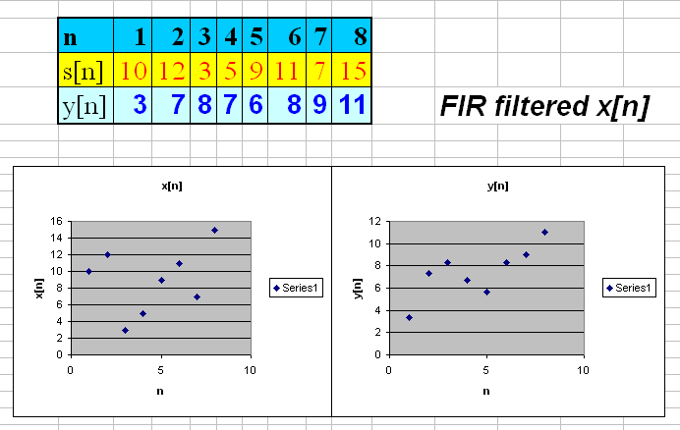
DSP Algorithms

Slide 26
FIR Filtering
y[n]=0.25*(x[n]+ x[n-1]+ x[n-2]+x[n-3])
Days | n | 1 | 2 | 3 | 4 | 5 | 6 | 7 | 8 | 9 | 10
Temperature | S[n] | 5 | 8 | 10 | 15 | 12 | 19 | 20 | 21 | 18 | 15
Average | y[n] | 1 | 3 | 6 | 10 | 11 | 14 | 17 | 18 | 20 | 19

Slide 27
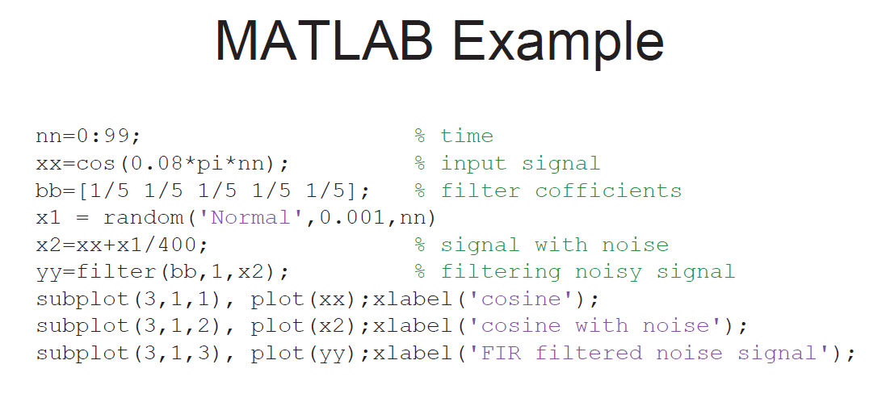
Signal Conditioning – Filtering

Slide 28
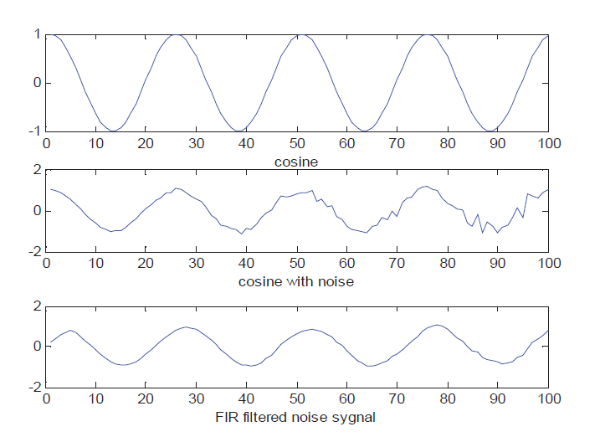
Signal Conditioning – Filtering

Slide 29
Signal Conditioning – Amplification
Amplification:
Increase voltage level to better match the DAQ input range, thereby increasing the measurement resolution and sensitivity.
Typical: Thermocouples, strain gages.
Amplifier

Slide 30
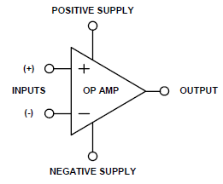
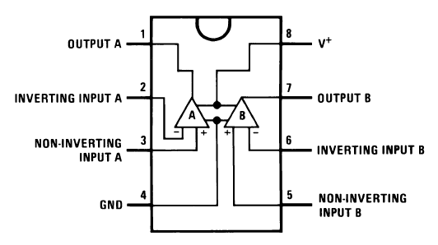
Signal Conditioning – Amplification
One popular device for signal amplification is the operational amplifier.
It is a differential amplifier, i.e. it amplifies the difference between its + and – inputs:
An ideal op amp has infinite gain (α).
In practice, this value is about 10⁵.
V-

Slide 31
Signal Conditioning – Amplification
Using the gain of 10⁵, we get the following output values based on input difference:
Input Difference (V) | Output (V)
1 x 10⁻⁶ | 0.1
1 x 10⁻⁵ | 1
1 x 10⁻⁴ | 10
1 x 10⁻³ | 100
1 x 10⁻² | 1,000
1 x 10⁻¹ | 10,000
1 | 100,000
But is this possible?

Slide 32
Signal Conditioning – Amplification
The op amp output is limited to the positive and negative supply.
Therefore if you supply +/-15V, then the maximum output is 15V and the minimum is -15V.
Open Loop
Inverting Input
V-
I-
Vout
∞
I+
V+
Output
Non Inverting Input
Zin,+,-=∞
I₊=I₋=0
G=∞
V₊=V₋
Z_{out}=0

Slide 33
Signal Conditioning – Amplification
Because the amplification gain is so huge (10⁵), an op amp in this form almost always goes into saturation, even with input difference of 15/10⁵V.
Not very useful this way…
Output
Input Difference (V) | Output (V)
1 x 10⁻⁶ | 0.1
1 x 10⁻⁵ | 1
1 x 10⁻⁴ | 10
1 x 10⁻³ | 15
1 x 10⁻² | 15
1 x 10⁻¹ | 15
1 | 15
15
Input Diff
-15

Slide 34
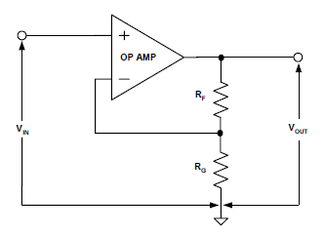
Signal Conditioning – Amplification
Good news is, we can control the gain to be smaller by using some feedback circuits. You can then get useful outputs.
Without going into the details of derivation:
Non-inverting op amp:
You now have the freedom to choose the resistance in order to obtain a reasonable gain.
E.g. R_{F}=990, R_{G}=10, then gain is ?

Slide 35
Non Inverting Amplifier
V₊=V₋=V_{in}
i_{in}=-V_{in}/R
i_{out} = (V_{out} –V_{in})/R_{F}
i_{in}
i_{out}
Vout
Vin

Slide 36
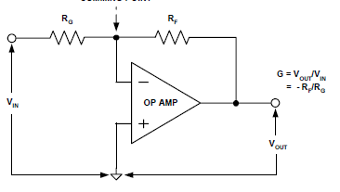
Signal Conditioning – Amplification
Inverting op amp:
E.g. if R_{F}=100, R_{G}=10, then gain ?

Slide 37
Inverting Amplifier
i_{out}
i_{in}
Vin
V_{c}
V_{out}

Slide 38
Summer / Adder
i_{out}
i_{in2}
i_{in1}
V_{in}
V_{out}

Slide 39
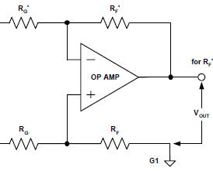
Signal Conditioning – Amplification
Differential op amp:
This circuit is very useful for the Wheatstone bridge circuit of strain gauge / load cell later.

Slide 40
Integrator
i_{out}
i_{in}
V_{in}
V_{out}

Slide 41
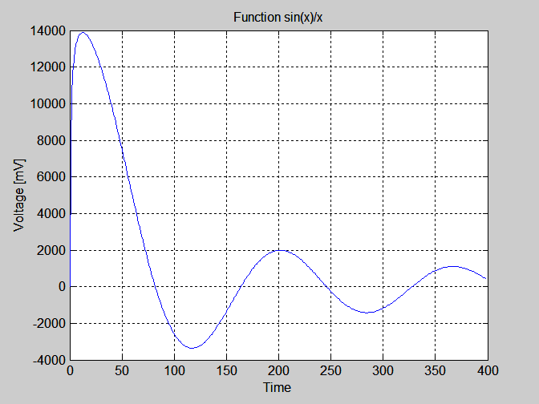
Integrate Function sin(x)/x
Mathematicians have
no analytical solution
But
Engineers have
hardware based
solution
We can integrate
anything

Slide 42
Differentiator
i_{out}
i_{in}
V_{in}
V_{out}

Slide 43
Comparator
Compare two signals
There is No feedback => infinite gain
Operates in saturation, ie
Maximum positive or
Maximum negative
output voltage
V_{out}

Slide 44
Buffer or Follower
V_{out}
V_{in}
Used to apply a signal without loading
the signal source
High input resistance isolates signal source from the
load

Slide 45
Exercises
V_{out}
Find:
V_{out}
I_{out}
I_{out}

Slide 46
Signal Conditioning - Isolation
Isolation:
Voltage signals well outside the range of the DAQ digitizer can damage the measurement system.
Signal Conditioning protects the system from dangerous voltages.
DAQ or expensive devices
Signal Conditioning
DAQ or expensive devices

Slide 47
Signal Conditioning - Isolation
Isolation:
Voltage signals well outside the range of the DAQ digitizer can damage the measurement system.
Isolation protects the system from dangerous voltages.
DAQ or expensive devices
Isolation
DAQ or expensive devices

Slide 48
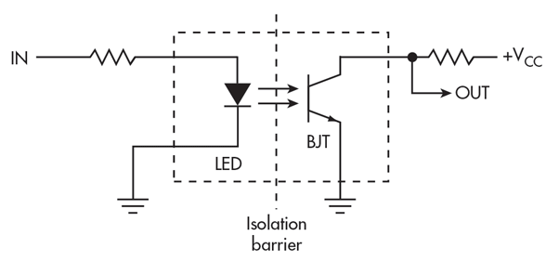
Signal Conditioning - Isolation
E.g. Optocoupler
No input:
LED is dark → Transistor (BJT) is off.
External pull-up resistor creates HIGH.
With input:
LED turns on → Transistor (BJT) on.
Output goes LOW.
http://www.electronicdesign.com/power/understanding-signal-and-power-isolation-techniques

Slide 49
Signal Conditioning - Excitation
Excitation:
Some sensors require external voltage or current excitation.
E.g. strain gauges are typically used in Wheatstone bridge configuration with voltage excitation.
R₁: Strain gauge
R₂
i₂
i₁
V_{ex}
A
Voltmeter
B
i₃
i₄
R₃
R₄: Potentiometer

Slide 50
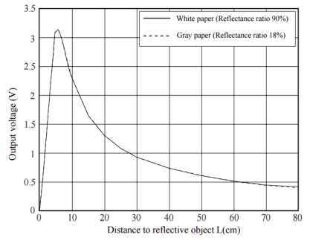
Signal Conditioning - Linearization
Linearization:
The process of interpreting signal from the sensor.
Can be implemented either with signal conditioning or through software (e.g. calibration and look up table, or equation).

Slide 51
Sampling and Aliasing
Imagine you are measuring a sine wave of 1Hz.
If your DAQ device can only read in values every 1s (or 2s, 3s…), you would see the samples as if they come from a straight line.
If the DAQ device can only read in values at other intervals longer than 0.5s, you will see some wave forms but they do not represent the original signal.
“Aliasing”
x
t
x
t

Slide 52
Sampling and Aliasing
Only if the DAQ device can read in data at 0.5s can you see a reconstructed signal similar to the original one:
Nyquist’s theorem: To avoid aliasing, the sampling rate must be greater than twice the maximum frequency component in the signal to be acquired.
In our example: Maximum frequency component in signal = 1Hz.
Thus we must sample at least at 2Hz (i.e. every 0.5s)
x
t

Slide 53
Sampling and Aliasing
Not completely true yet! The frequency of the reconstructed signal is correct, but not necessarily the shape.
To preserve the shape of the signal, the sampling rate should be faster than 0.5s.
x
t
x
t

Slide 54
Content
Introduction to Data Acquisition
Introduction to NI myRIO

Slide 55
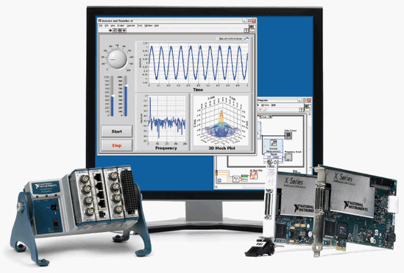
LabVIEW DAQ Devices
Desktop DAQ Devices:
PCI DAQ board which needs to be plugged into PC.
Software runs on PC.
Portable DAQ Devices:
Connected using USB, Wifi etc.
Software runs on PC.
Distributed DAQ Devices:
Software developed on PC,
Then downloaded to device.
NI DAQ Device
http://www.ni.com/newsletter/51296/en/

Slide 56
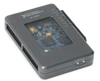
NI myRIO-1900
The National Instruments myRIO-1900 is a reconfigurable I/O device.
Can be used to design control, robotics and mechatronics systems.
Uses Zynq technology from Xilinx featuring an FPGA
Integrated with a processor running a real-time OS.
8 single ended 0-5V Analog Inputs
2 differential +/-10V Analog Inputs
4 single ended 0-5V Analog Outputs
2 single ended +/- 10V Analog Outputs
40 Digital Inputs or Outputs
ADC Resolution is the resolution of the ADC in bits
What is ADC Resolution and Precision of myRIO inputs and outputs
NI myRIO 1900
http://sine.ni.com/nips/cds/view/p/lang/en/nid/211694

Slide 57
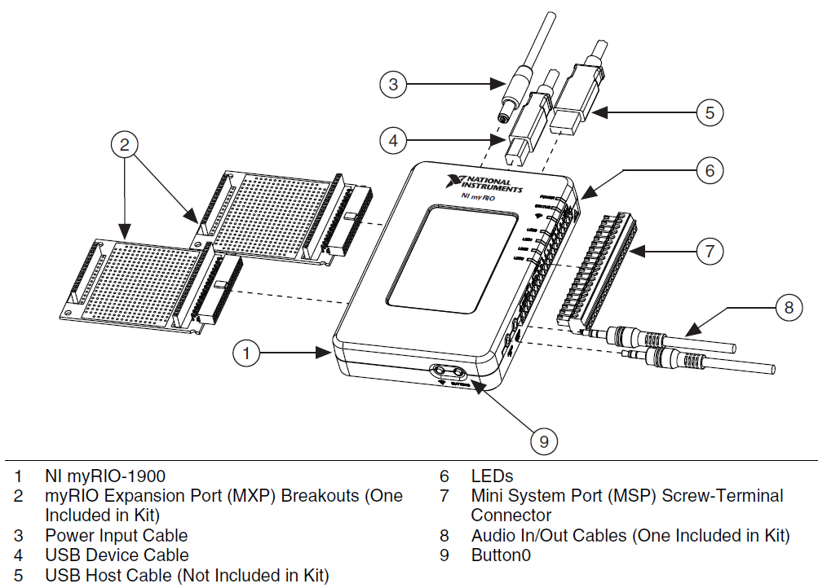
NI myRIO-1900

Slide 58
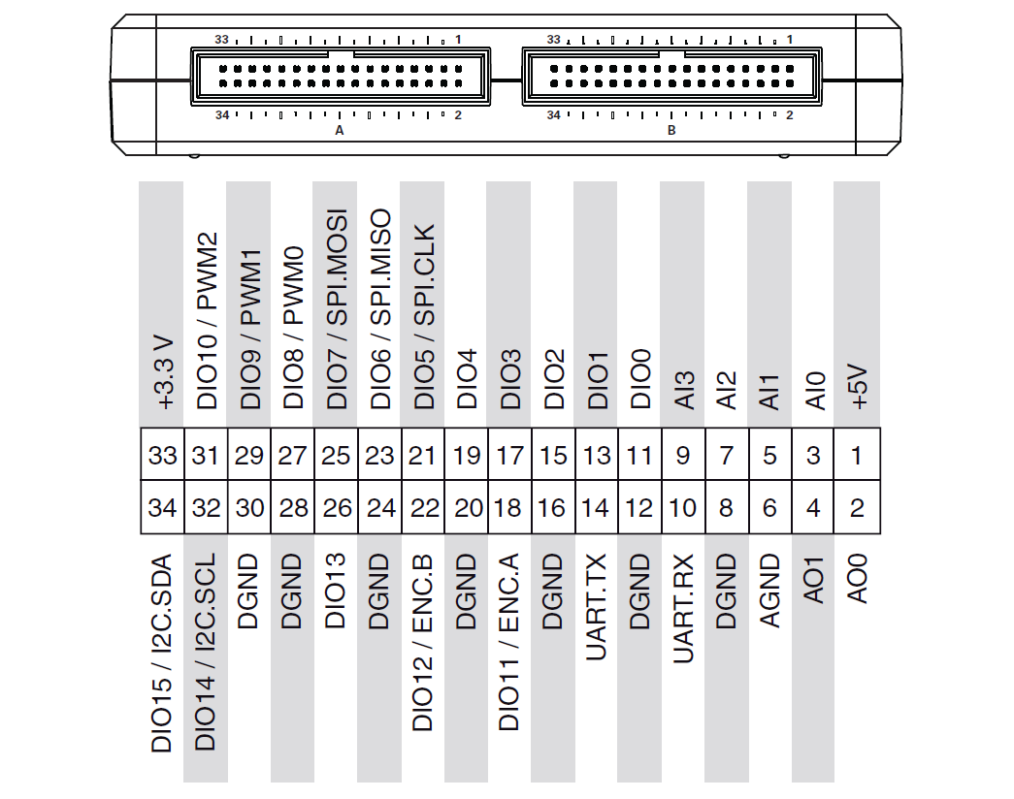
MXP Connectors A & B

Slide 59
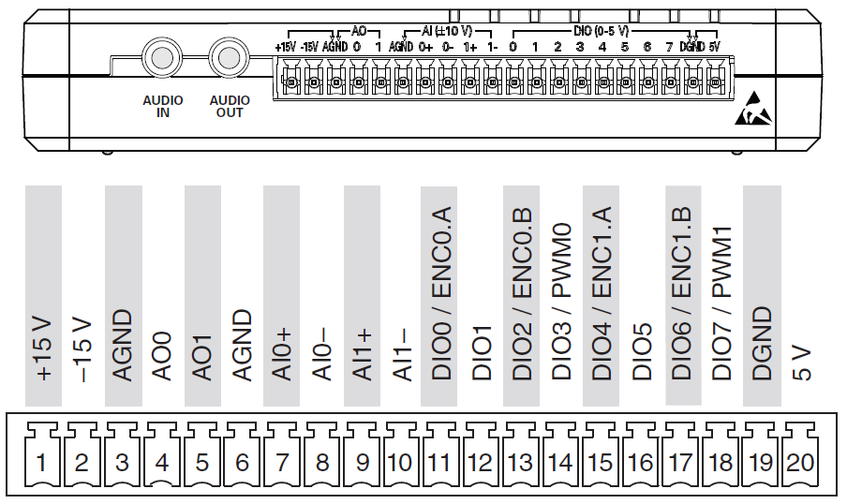
MSP Connector C

Slide 60
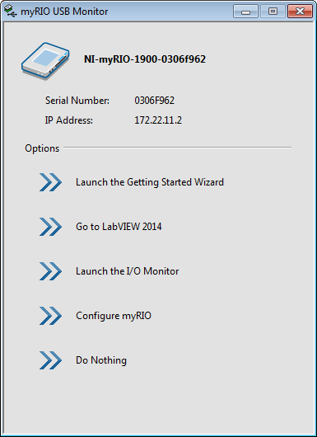
Getting Started
Install all the necessary LabVIEW components (myRIO toolkit and Real Time Module).
Also install optional modules (FPGA Module, Compilation Tools for Vivado)
Connect myRIO to the PC via a USB cable.
PC will automatically detect myRIO and the following dialogue will pop up:
If it is the first time myRIO is connected to PC, you must click “Launch the Getting Started Wizard” to install software on the myRIO.

Slide 61
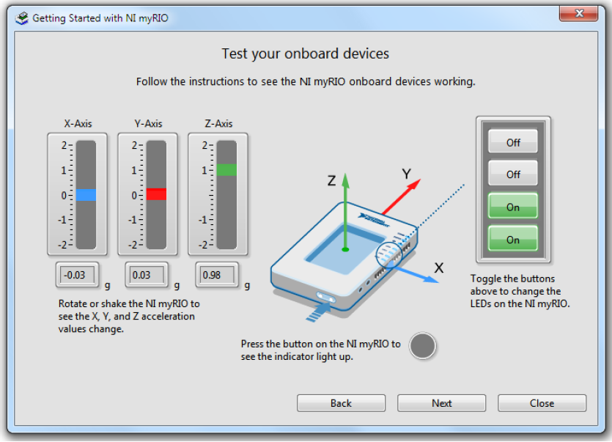
Getting Started
“Launch the Getting Started Wizard” activates a test panel, allowing you to test the onboard devices (accelerometer, LED’s)
The next time you connect the myRIO to your PC, you can skip to other options on the pop-up dialogue.

Slide 62

Thank you, Questions

